Slide 1
K-Means, CNN and Transfer Learning for Image Classification
Abhijith Dameruppala

Slide 2
Problem Statement
In this project we will be classifying images from a data set using unsupervised learning(K-Means) and deep learning techniques(CNN, Transfer Learning)
The Data Set: Images of CATS and DOGS from www.tensorflow.org
Algorithms Used: K-Means and CNN and Transfer Learning (for better accuracy of the model)

Slide 3
K-Means Clustering
K Means is a Divide and Conquer algorithm that divides n data points into k clusters/groups.
It is a centroid based algorithm.
In this method, we assign a centroid to a cluster and the whole algorithm tries to minimize the sum of the distances between the centroid of the cluster and the datapoints inside that cluster.

Slide 4
Algorithm of K Means
We need to define the number of clusters for the algorithm.
In our case, it is 2(cat and dog)
Select k random points from the data as a center
Associate each data point with the nearest center calculating the Euclidean Distance.
Calculate the centroid and mean of all data points in the cluster.
Repeat 2, 3, 4 steps until the stopping criteria

Slide 5
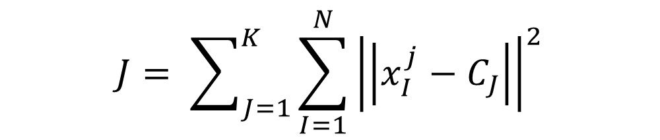
Stopping Criteria
The Maximum number of iterations is reached.
Centroid of the newly formed cluster does not change.
Data points remain in the same cluster.
$$J= \sum_{J=1}^{K}{\sum_{I=1}^{N}{{\left|\left|x_{I }^{j}−C_{J}\right|\right|}^{2}}}$$

Slide 6
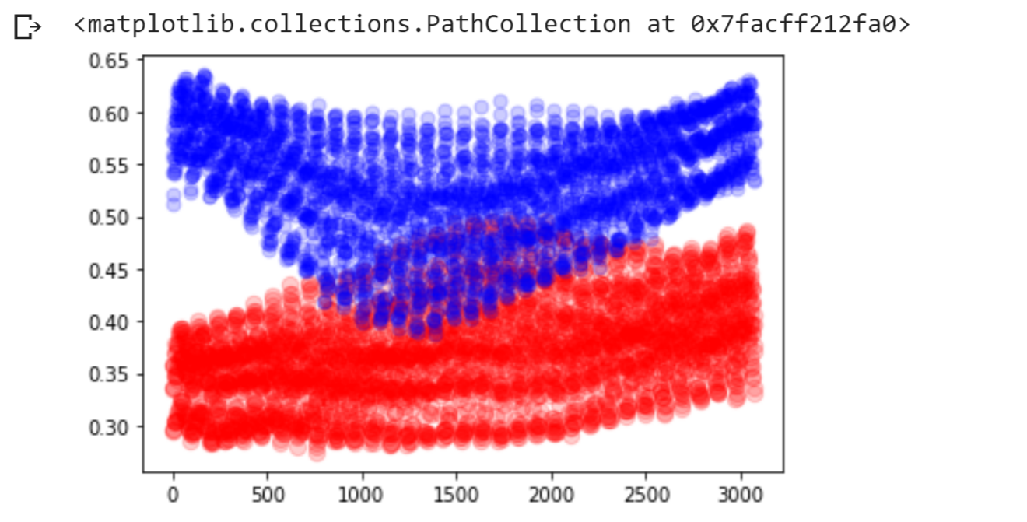
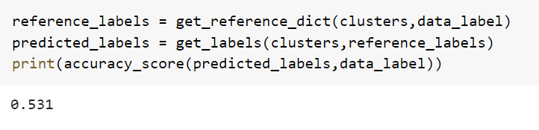
Cluster Analysis of CAT and DOG classes:
Accuracy of the model:

Slide 7
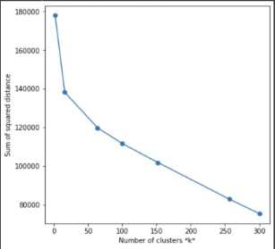
Elbow Method
This method is based upon the Sum of Squared Distance between data points and their closest centroid.
Accuracy for k = 2: 0.531
Accuracy for k = 16: 0.573
Accuracy for k = 64: 0.629
Accuracy for k = 100: 0.635
Accuracy for k = 152: 0.656
Accuracy for k = 256: 0.704
Accuracy for k = 300: 0.718

Slide 8
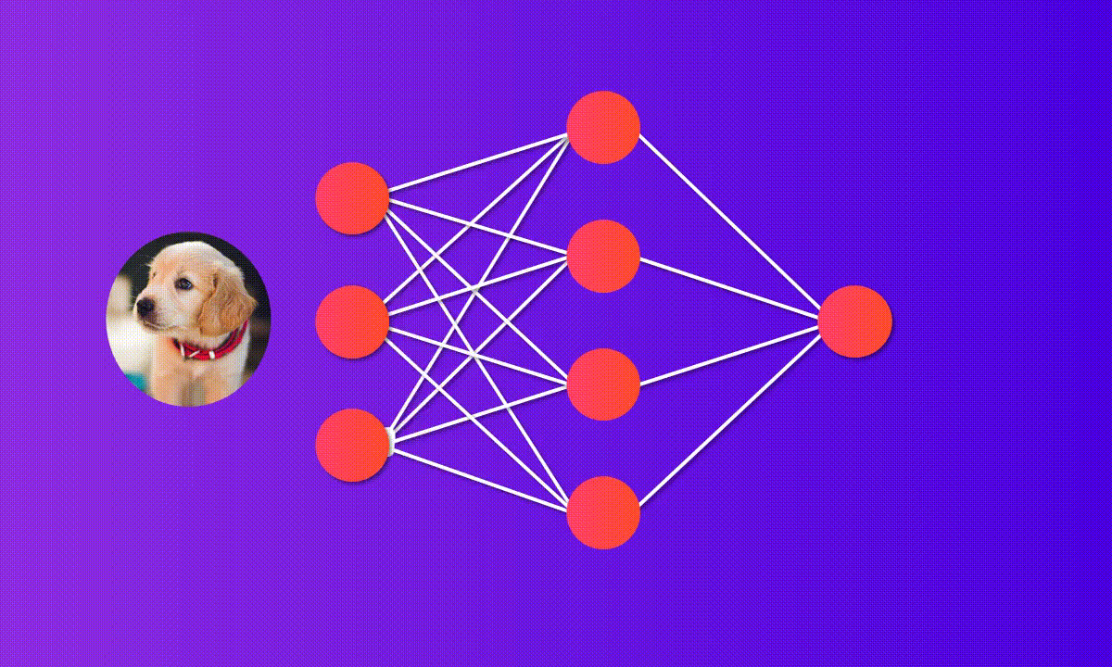
CONVOLUTION NEURAL NETWORK

Slide 9
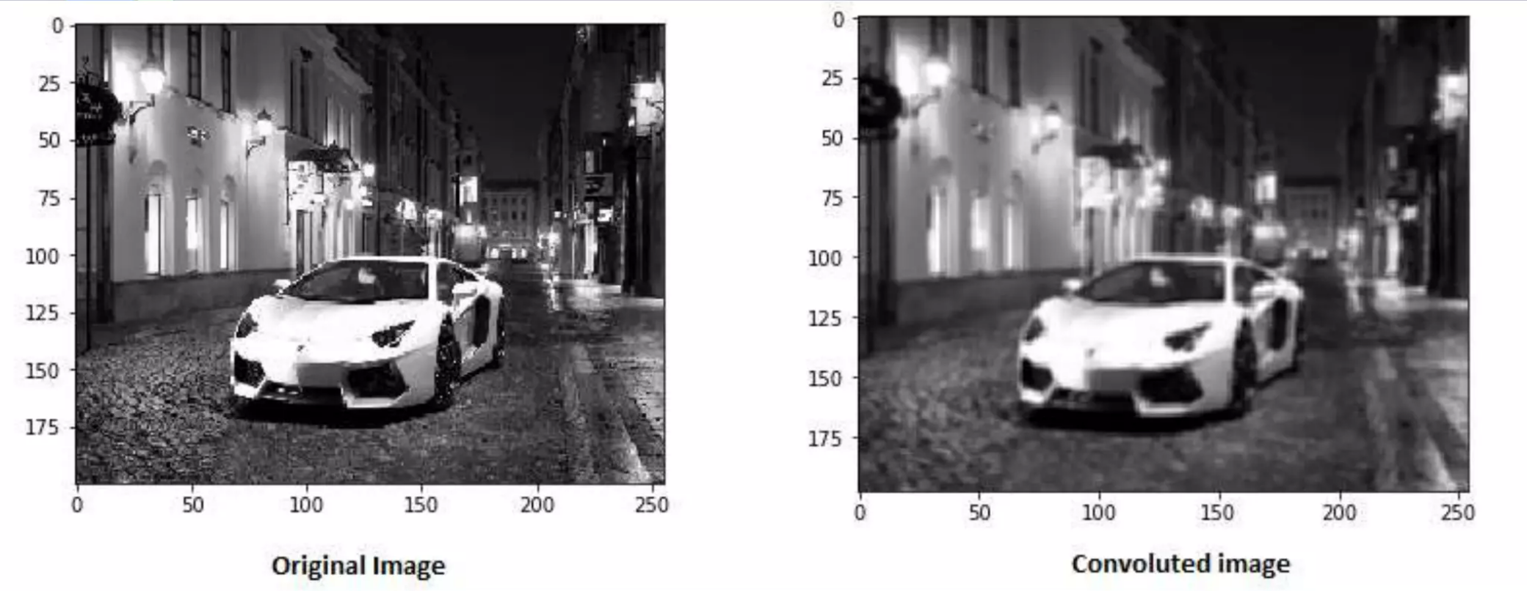
CNN is a multi-layered neural network comprised of pooling layers, and then connected by fully connected layers.
Convolution Layer:

Slide 10

Feature Extraction:

Slide 11
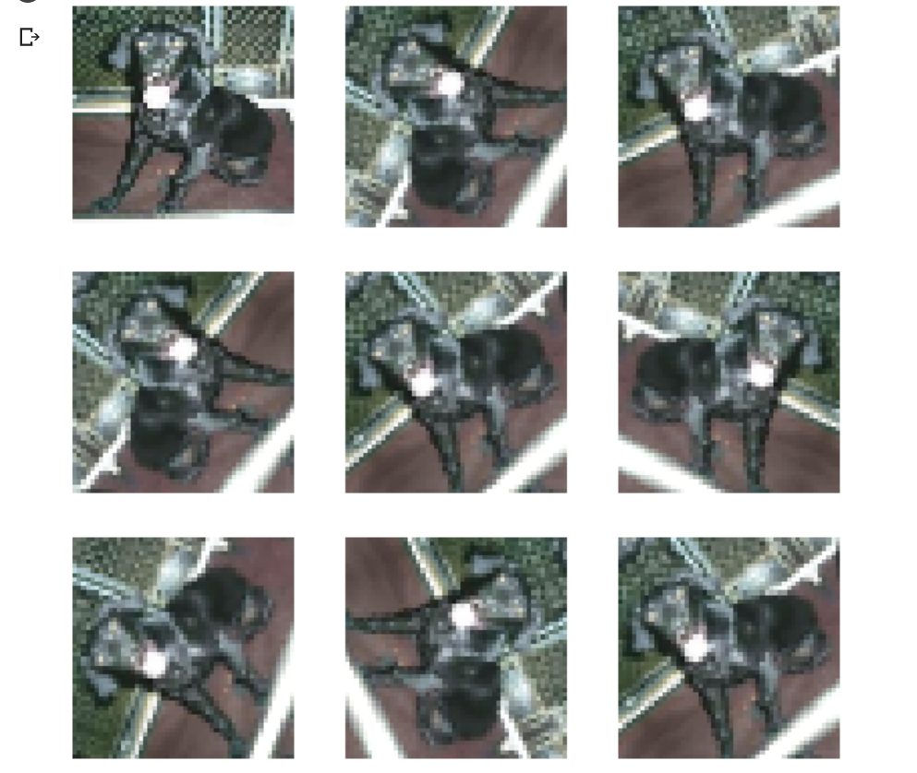
Data Augmentation:

Slide 12
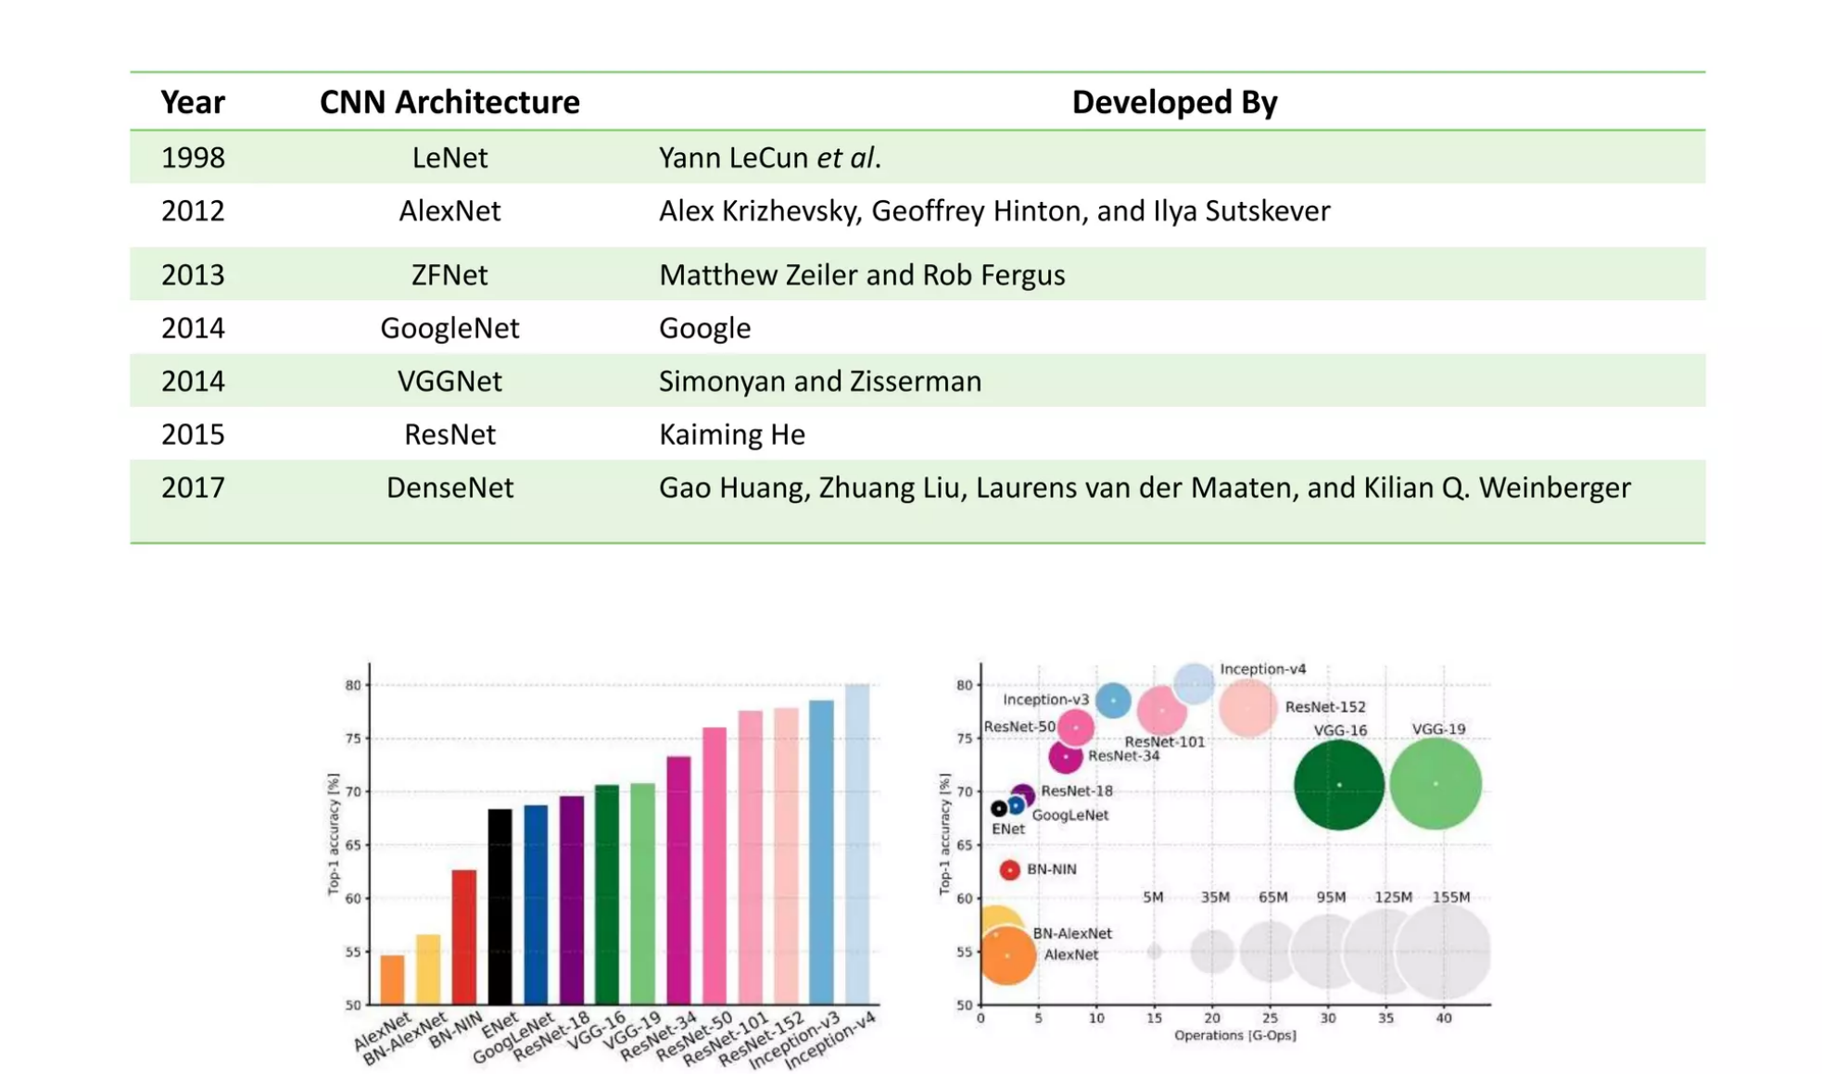
CNN Architectures

Slide 13
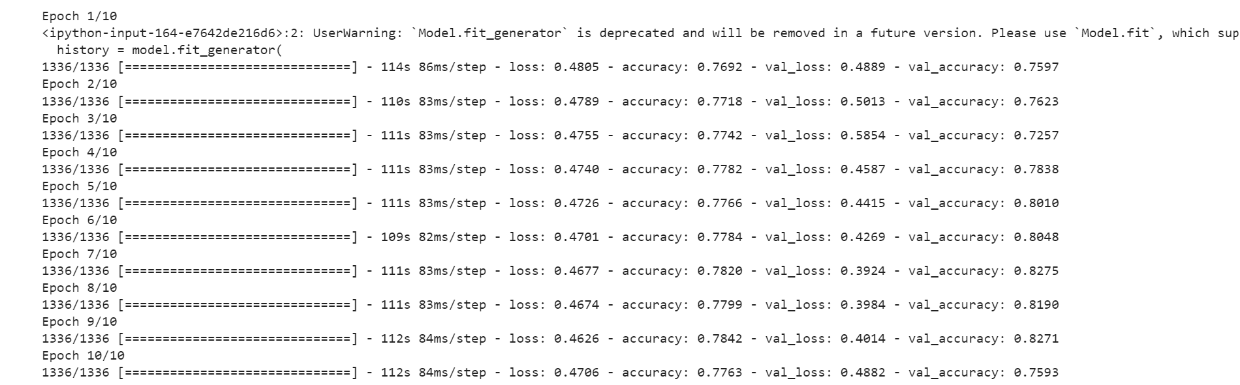
Training the data set over 10 epochs
Final accuracy after 10 epochs = 77.63%

Slide 14
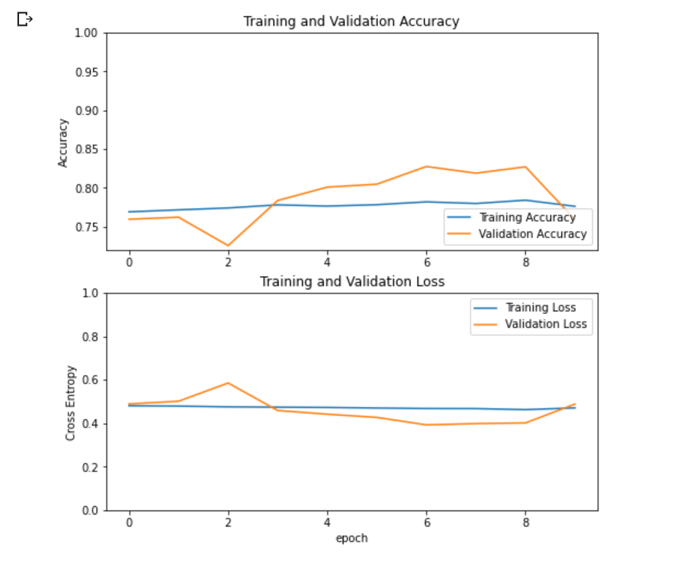
Accuracy v/s Loss for CNN Model

Slide 15
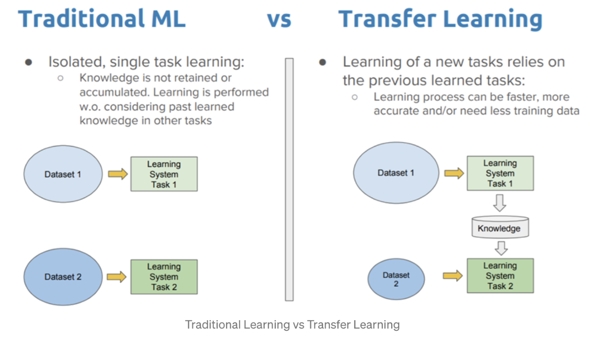

Slide 16
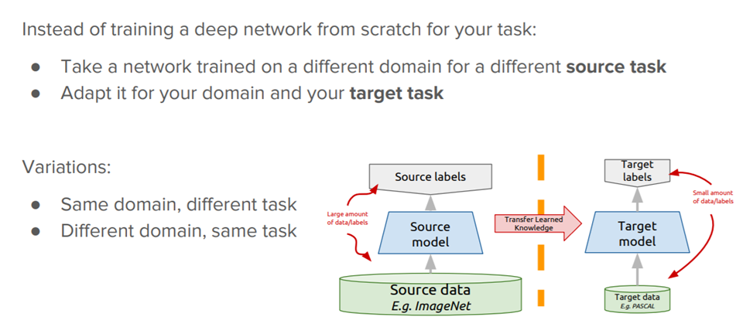
TRANSFER LEARNING:

Slide 17
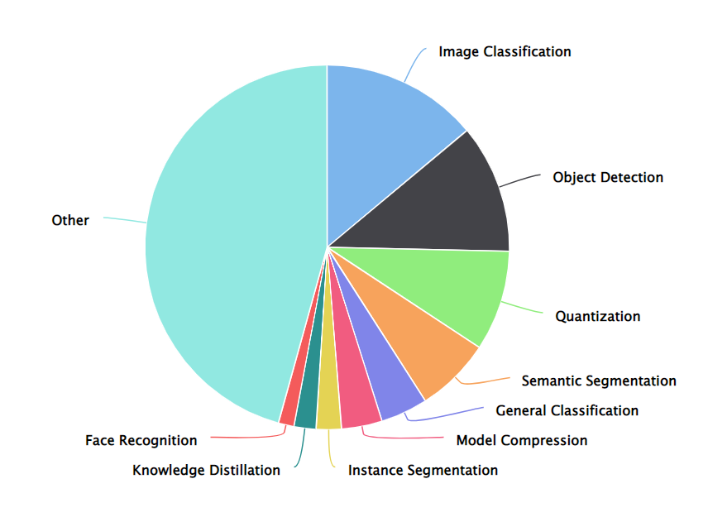
Popularity of MobileNet V2

Slide 18
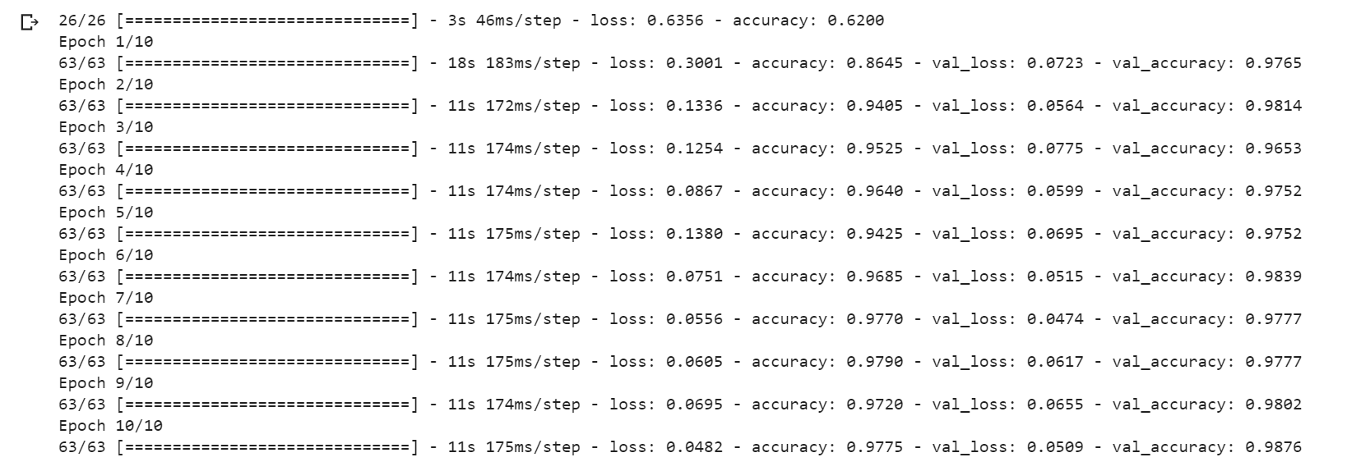
Training the data set over 10 epochs
Final accuracy after 10 epochs = 97.75%

Slide 19
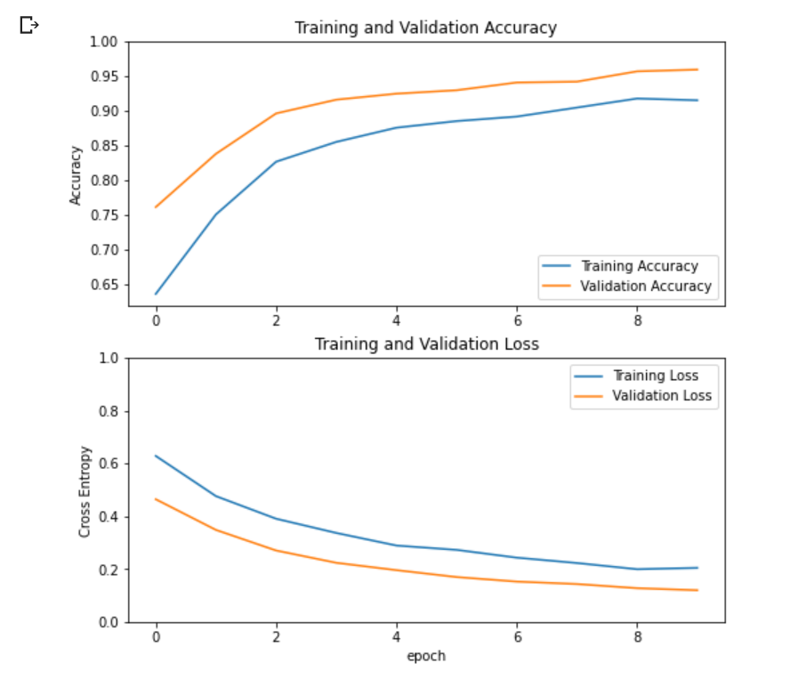
Accuracy v/s Loss for Transfer Learning Model

Slide 20
References
https://towardsdatascience.com/
https://paperswithcode.com/
https://www.tensorflow.org/
https://data-flair.training/
Research Papers:
MobileNetV2 (https://arxiv.org/abs/1801.04381v4)
Deep Residual Learning (https://arxiv.org/abs/1512.03385v1)

Slide 21

Q&A ?

